Slide 1
Systems Design
Systems Analysis and Design
By: Isaac Tomusange

Slide 2
Systems Design
This provides details of how a system will meet the information requirements as determined by the Analyst.
It should be noted that the primary input to design is the requirements specification document, which is the output from analysis. This document is critical to the success of the system because it represents the users’ requirements of the system.
8-<number>

Slide 3
Systems Design
  Much of the contents of this document get transformed into design equivalents as the Analysts begin to customise the proposed IS for the specific h/w & s/w platforms to be used for its creation and ultimate operation in some production environment within an organisation.
  These specifications should be detailed enough to become inputs to the programming stage that follows the design. The design process is usually broken down into 2 parts.
8-<number>

Slide 4
Logical Design: produces the general specification of the resources that will make up the system. It lays out the components of the IS & their relationship to each other as they appear to users.
Physical Design: produces a complete, detailed specification of the named program components & of the databases to be maintained by the system. It also involves the process of translating the abstract logical model into the specific technical design for the new system.
8-<number>

Slide 5
The physical design addresses all of the environment, platform & human-computer interface specifics for the proposed IS . Issues to be discussed & decided here include all aspects of the 5 components of an IS such as h/w, s/w, data, people, procedures.
8-<number>

Slide 6
Objectives of Systems Design
Specify logical design elements: detailed design specifications that describe the features of an IS (i/p, o/p, files, DBs & procedures)
Support business activities: results of using the system help business performance. Design fits the way the firm conducts its business.
Provide software specifications: specific components & functions with adequate detail to construct application software.
8-<number>

Slide 7
Meet user requirements: in terms of performing appropriate procedures correctly, presenting proper form of information, providing accurate results, using appropriate methods of interaction, providing overall reliability.
Easy to use: favourable human engineering, ergonomic design that is physically comfortable & contributes to user effectiveness & efficiency.
Conform to design standards: design & specification of the design in accordance with prescribed rules & practices of the organisation.
8-<number>

Slide 8
Architectural Design
This is the design process of identifying subsystems of a large system & establishing a frame work for sub-system control & communication.
It involves identifying major system components & their communication.
A sub-system is a system in its own right whose operation is independent of the services provided by other sub-systems & a module is a system component that provides services to other components but would not normally be considered as a separate system.
8-<number>

Slide 9
Architectural Design Process
System structuring: the system is decomposed into several principal sub-systems & communication between these sub-systems are identified.
Control Modelling: a model of the control relationships between the different parts of the system is identified.
Modular decomposition: the identified sub-systems are decomposed into modules.
8-<number>

Slide 10
Features to be designed (Logical Design)
Design specifications describe the features of a system. These are the elements of the system & their appearance to the users. These include:
  - Data Flows: movement of data into, around & out of the system are specified.
  - Data stores: temporary /permanent collections of data are specified.
  - Processes: activities to accept, manipulate & deliver data & information. May be manual or automated.
8-<number>

Slide 11
- Procedures: methods & routines for using the IS to achieve the intended results, are specified.
- Roles: the responsibilities of all persons involved with the new system, including end-users, computer operators & support personnel are specified.
- Controls: standards & guidelines for determining whether activities are occurring in the anticipated/accepted manner i.e. under control. It also specifies actions to take when problems/unexpected circumstances are detected. May include the reporting of exceptions/procedures for correcting problems.
8-<number>

Slide 12
Features to be designed (Physical Design)
The following aspects of the system are specified:
- System outputs: report layouts, document designs, screen designs
- System inputs: data inputs and their validation procedures.
- user-interface: exact protocols of user-system interaction (menu trees, icons for graphic interfaces e.t.c)
- Platforms: h/w and s/w platform(s)
- Acquisition method: the way each component of the application will be acquired.
8-<number>

Slide 13
- Modular design: of the programs that will be developed for the application, interfaces between the modules & the specification of the logic of the individual modules. The algorithms to be implemented in each module are selected.
- Detailed Test plan: the plan for various levels of testing to be conducted during the later stages of development & a test suite containing the sets of tests for these levels.
- Database: needed capacities of files & databases or data storage components are identified.
8-<number>

Slide 14
- Controls: application-specific controls, as well as the necessary general controls.
- Documentation: a full set of documentation to be delivered with the system. This includes user manuals, system & operation documentation, maintenance documentation. The requirement specification & the system design documentation will also be included in the documentation package.
- Conversion plan: the plan for converting the present way of doing things to the new system.
8-<number>

Slide 15
Techniques & Tools Used in Design
Structured Design: the principal product of logical design are structure charts of the programs that need to be coded & tested. They are 2 kinds:-
- modular structure
- Hierarchical structure
8-<number>

Slide 16
Modular design
COMPUTER-SALES TOTAL
READ-SALES
TRANSACTION
ADD-TO-TOTAL
OUTPUT TOTAL
8-<number>

Slide 17
Hierarchical design
A
B
C
8-<number>

Slide 18
Designing Effective Output

Slide 19
Major Topics
Designing output
Output technologies
Factors in choosing an output technology
Report design
Screen design
Web site design
8-<number>

Slide 20
Designing Output
Output should be designed to:
  Serve the intended purpose.
  Be meaningful to the user.
  Deliver the right quantity of output.
  Deliver it to the right place.
  Provide output on time.
  Choose the right output method.
8-<number>

Slide 21
Output Types
Internal output: intended to be used within the organization.
External output: intended to be used outside the organization. This differs from internal output in terms of design & appearance.
A turnaround output: generally external & people-oriented & has the dual purpose of serving as output to the user & input to the IS from the user.
2005 Pearson Prentice Hall
1-<number>

Slide 22
Other Types:
Static output: can be predetermined & planned for.
Dynamic output: cannot be easily predetermined or planned for during IS development.
2005 Pearson Prentice Hall
1-<number>

Slide 23
Output Technologies
Output can be in the form of:
  Print.
  Display screen.
  Audio.
  CD-ROM or CD-RW.
  DVD.
  Electronic output.
8-<number>

Slide 24
Output Technologies (Continued)
Output technologies differ in their:
  Speed.
  Cost.
  Portability.
  Flexibility.
  Storage and retrieval possibilities.
8-<number>

Slide 25
Characteristics of Good Output
A number of characteristics make information a candidate to be considered both high quality & usable.
- Accessibility: ease of use of the information when received.
- Timeliness: Amount of time that elapses to obtain specific information needed.
- Accuracy: information being error-free.
2005 Pearson Prentice Hall
1-<number>

Slide 26
- Relevancy: whether the information presented is free from trivial/superfluous details or lacking sufficient details.
- Usability: refers primarily to the presentation style of the information i.e. its format e.g text, numbers, graphics e.t.c.
2005 Pearson Prentice Hall
1-<number>

Slide 27
Video Clips
Video clips are useful for:
  Supplementing static, printed output.
  Distance collaboration.
  Showing how to perform an action.
  Providing brief training episodes.
  Shifting the time of an actual event by recording it for later output.
  Preserving an important occasion for addition to an organization’s archives.
8-<number>

Slide 28
Animation
Animation is composed of four elements:
  Elemental symbols.
  Spatial orientation.
  Transition effects.
  Alteration effects.
8-<number>

Slide 29
Electronic Output
Electronic output includes:
  Fax.
  Electronic mail (email).
  The World Wide Web.
8-<number>

Slide 30
Push and Pull Technology
Pull technology allows the user to take formatted data from the Web.
Push technology sends solicited or unsolicited information to a customer or client.
8-<number>

Slide 31
Factors in Choosing an Output Technology
Factors that must be considered when choosing an output technology are:
  Who will use the output?
  How many people need the output?
  Where is the output needed?
  What is the purpose of the output?
  What is the speed with which output is needed?
8-<number>

Slide 32
Factors in Choosing an Output Technology
  Factors that must be considered when choosing an output technology are (continued):
  How frequently will the output be accessed?
  How long will the output be stored?
  Under what special regulations is the output produced, stored, and distributed?
  What are the initial and ongoing costs of maintenance and supplies?
  What are the environmental requirements for output technologies?
8-<number>

Slide 33
Output Bias
Analysts must be aware of sources of output bias and inform users of the possibilities of bias in output.
Bias is introduced in three main ways:
  How information is sorted.
  Setting of acceptable limits.
  Choice of graphics.
8-<number>

Slide 34
Strategies to Avoid Bias
Strategies to avoid output bias:
  Awareness of the sources of bias.
  Design of output that includes users.
  Working with users so that they are informed of the output's biases.
  Creating output that is flexible and allows users to modify limits and ranges.
  Train users to rely on multiple output for conducting "reality tests" on system output.
8-<number>

Slide 35
Report Design Considerations
Constant information does not change when the report is printed.
Variable information changes each time the report is printed.
Paper quality, type, and size should be specified.
8-<number>

Slide 36
Printed Reports
Design reports using software.
Design guidelines for printed reports are:
  Include functional attributes, such as headings, page numbers, and control breaks.
  Incorporate stylistic and aesthetic attributes, such as extra blank space and grouping data.
8-<number>

Slide 37
Display Screen Design
Guidelines for display design are:
  Keep the display simple.
  Keep the display presentation consistent.
  Facilitate user movement among displayed output.
  Create an attractive display.
8-<number>

Slide 38
Graphical Output
Primary considerations for designing graphical output:
  Output must be accurate, easy to understand and use.
8-<number>

Slide 39
Graphical Output (Continued)
The analyst must determine:
  The purpose of the graph.
  The kind of data to be displayed.
  The audience.
  The effects on the audience of different kinds of graphical output.
8-<number>

Slide 40
Web Site Design
Design principles must be used when designing Web sites.
These include:
  Using professional tools.
  Studying other sites.
  Using Web resources.
  Examining the sites of professional Web site designers.
8-<number>

Slide 41
Web Site Design (Continued)
Further principles:
  Using tools that you are familiar with.
  Consulting books.
  Examining of poorly designed pages.
  Creating Web templates. Style sheets allow you to format all Web pages in a site consistently.
  Using plug-ins, audio, and video sparingly.
8-<number>

Slide 42
Plan Ahead
Pay attention to:
  Structure.
  Content.
  Text.
  Graphics.
  Presentations style.
  Navigation.
  Promotion.
8-<number>

Slide 43
Web Graphics
Guidelines for using graphics when designing Web sites are:
  Use either JPEG or GIF formats.
  Keep the background simple and readable.
  Create a few professional-looking graphics for use on your page.
  Reuse bullet or navigational buttons.
  Examine your Web site on a variety of monitors and graphics resolutions.
8-<number>

Slide 44
Presentation Style
Guidelines for entry displays for Web sites:
  Provide an entry screen or home page.
  Keep the number of graphics to a reasonable minimum.
  Use large and colorful fonts for headings.
  Use interesting images and buttons for links.
8-<number>

Slide 45
Presentation Style
Guidelines for entry displays for Web sites (continued)
  Use tables to enhance the layout.
  Use the same graphics image on several Web pages.
  Avoid overusing animation, sound, and other “busy” elements.
8-<number>

Slide 46
Navigation
Navigation guidelines:
  Use the three-clicks rule.
  Promote the Web site.
  Encourage your viewers to bookmark your site.
8-<number>

Slide 47
Output Production and XML
An XML document may be transformed into different media types.
There are two methods:
  Using cascading style sheets (CSS).
  Using Extensible Style Language Transformations (XSLT).
8-<number>

Slide 48
Cascading Style Sheets (CSS)
CSS allows you to specify the font family, color, size, and so on.
Styles may be set up for different media, such as display, print, or handheld devices.
Styles do not allow you to select or sort XML elements.
8-<number>

Slide 49
Extensible Style Language Transformations (XSLT)
XSLT allows you to:
  Select XML elements.
  Sort.
  Select data to be output.
8-<number>

Slide 50
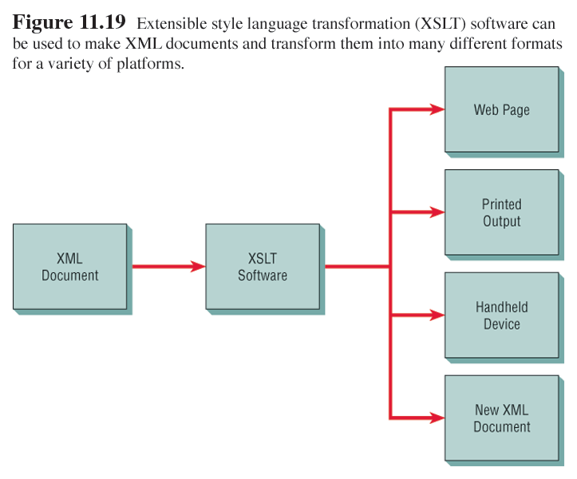
Extensible Style Language Transformations (XSLT)
8-<number>

Slide 51
Designing Effective Input

Slide 52
Major Topics
Input design
Form design
Display design
GUI screen design
GUI controls
Web design guidelines
8-<number>

Slide 53
Input Design Objectives
The quality of system input determines the quality of system output.
Well-designed input objectives:
  Effectiveness.
  Accuracy.
  Ease of use.
  Consistency.
  Simplicity.
  Attractiveness.
8-<number>

Slide 54
Form Design
Guidelines for good form design:
  Make forms easy to fill out.
  Ensure that forms meet the purpose for which they are designed.
  Design forms to assure accurate completion.
  Keep forms attractive.
8-<number>

Slide 55
Form Completion
To make forms easy to fill out, the following techniques are used:
  First, design forms with proper flow, from left to right and top to bottom.
  Second, group information logically using the seven sections of a form.
  Third, provide people with clear captions.
    Captions tell the person completing the form what to put on a blank line, space, or box.
8-<number>

Slide 56
Seven Sections of a Form
The seven sections of a form are:
  Heading.
  Identification and access.
  Instructions.
  Body.
  Signature and verification.
  Totals.
  Comments.
8-<number>

Slide 57
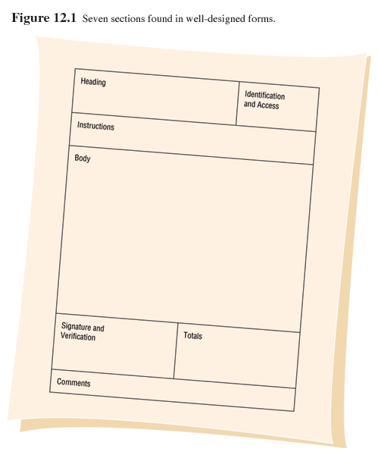
Seven Sections of a Form
8-<number>

Slide 58
Caption Types
Captions may be one of the following:
  Line caption, putting the caption on the same line or below the line.
  Boxed caption, providing a box for data instead of a line.
  Vertical check off, lining up choices or alternatives vertically.
  Horizontal check off, lining up choices or alternatives horizontally.
8-<number>

Slide 59
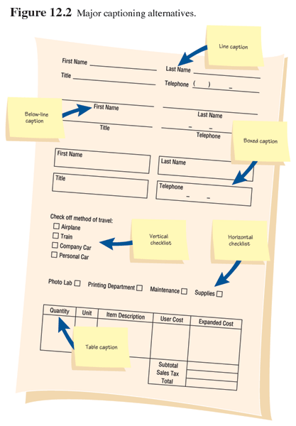
Caption Types
8-<number>

Slide 60
Meeting the Intended Purpose
  Systems analysts may use different types of specialty forms for different purposes.
  Specialty forms can also mean forms prepared by a stationer.
8-<number>

Slide 61
Ensuring Accurate Completion
To reduce error rates associated with data collection, forms should be designed to assure accurate completion.
Design forms to make people do the right thing with the form.
To encourage people to complete forms, systems analysts should keep forms attractive.
8-<number>

Slide 62
Attractive Forms
To be more attractive, forms should look uncluttered, and elicit information in the expected order.
Aesthetic forms or usage of different fonts and line weights within the same form can help make it more attractive.
8-<number>

Slide 63
Computer Form Design Software
Numerous microcomputer form design software is available.
Features of electronic form design software:
  Ability to design paper, electronic, or Web- based forms.
  Form design using templates.
  Form design by cutting and pasting familiar shapes and objects.
8-<number>

Slide 64
Computer Form Design Software (Continued)
Features of the electronic form design software
  Facilitates completion through the use of software.
  Permits customized menus, toolbars, keyboards, and macros.
  Supports popular databases.
  Enables broadcasting of electronic forms.
  Permits sequential routing of forms.
8-<number>

Slide 65
Computer Form Design Software (Continued)
Features of electronic form design software
  Assists form tracking.
  Encourages automatic delivery and processing.
  Establishes security for electronic forms.
8-<number>

Slide 66
Controlling Business Forms
Controlling forms include:
  Making sure that each form in use fulfills its specific purpose.
  Making sure that the specified purpose is integral to organizational functioning.
  Preventing duplication of information collected and the forms that collect it.
  Designing effective forms.
8-<number>

Slide 67
Controlling Business Forms (Continued)
Controlling forms include:
Deciding on reproduce forms in the most
economical way
  Establishing stock control and inventory procedures that make forms available when needed, at the lowest possible cost
8-<number>

Slide 68
Display Design Guidelines
Guidelines for good display design:
  First, keep the display simple.
  Second, keep the display presentation consistent.
  Third, facilitate user movement among display screens.
  Finally, create an attractive display.
8-<number>

Slide 69
Three Screen Sections
To keep the screen simple, it is divided into three sections:
  Heading.
  Body.
  Comments and instructions.
8-<number>

Slide 70
Display Design Concepts for Simplicity
Displaying a few necessary basic commands using windows or hyperlinks is another way to keep screens simple.
For the occasional user, only 50 percent of the screen should contain useful information.
8-<number>

Slide 71
Display Design Concepts for Simplicity (Continued)
Simplistic design includes maximizing or minimizing the window size as needed.
Use context-sensitive help and other pop-up menus.
Consistency is achieved by displaying information in the same area or by grouping information logically.
8-<number>

Slide 72
Facilitating Movement
Guidelines for facilitating movement from one page to another:
  Clicking--the three clicks rule says that users should be able to get to the screens they need within three mouse or keyboard clicks.
  Scrolling--using arrows or PgDn keys.
  Using context-sensitive pop-up windows.
  Using onscreen dialogue .
8-<number>

Slide 73
Designing an Attractive Screen
To make the screen attractive use:
  Different thickness of separation lines between subcategories.
  Inverse video and blinking cursors.
  Different combinations of colors.
  Different type fonts.
8-<number>

Slide 74
Using Icons in Screen Design
Icons are used in graphical screens to run programs and execute commands.
Graphical User Interface (GUI) are used in conjunction with a mouse, keyboard, lightpen, or joystick for making selections and entering data.
8-<number>

Slide 75
Graphical User Interface (GUI) Controls
GUI controls or fields:
  Text boxes.
  Check boxes.
  Option or radio buttons.
  List and drop-down list boxes.
  Sliders and spin buttons.
  Image maps.
  Text area.
  Message boxes.
8-<number>

Slide 76
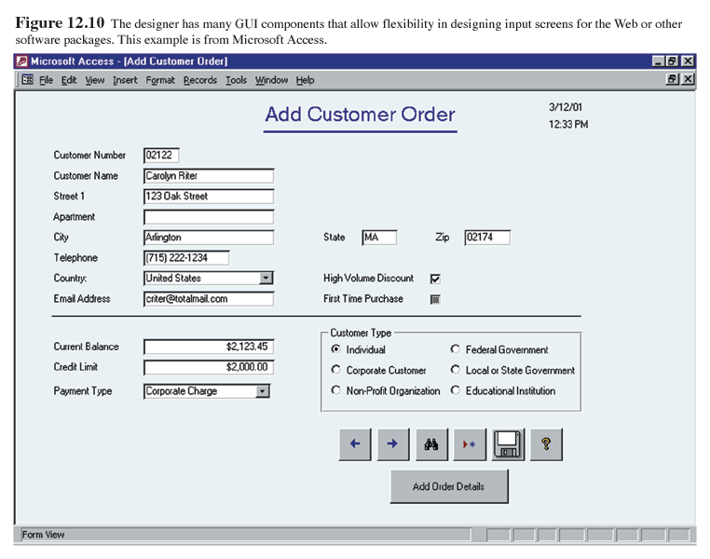
GUI Screen Example
8-<number>

Slide 77
Text Boxes
Text boxes should be large enough to accommodate all the field characters.
Captions should be to the left of the text box.
Character data should be left aligned within the box.
Numeric data right aligned.
8-<number>

Slide 78
Check Boxes
Check boxes are used for nonexclusive choices.
Check box text or label is placed to the right of the check box.
If there are more than 10 check boxes, group in a bordered box.
8-<number>

Slide 79
Option Buttons and Drop-down List Boxes
Option or radio buttons are used for exclusive choices.
Often they are placed in a rectangle called an option group.
List and drop-down list boxes are used to select one choice out of many.
8-<number>

Slide 80
Sliders, Spin Buttons, and Image Maps
Sliders and spin buttons are used to change data that have a continuous range of values.
Image maps are used to select values within an image.
  The x and y coordinates are sent to the program.
8-<number>

Slide 81
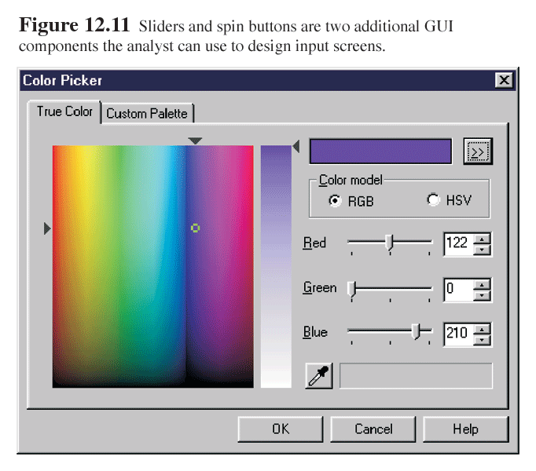
Slider and spin button example
8-<number>

Slide 82
Text Area
A text area is used for entering a larger amount of text.
These areas may have text that wraps when the text reaches the end of the box.
There are two ways to handle the text:
  Hard return is used to force new lines.
  Use word wrap within the text area.
8-<number>

Slide 83
Message Boxes and Command Buttons
Message boxes are used to display warning and other messages in a rectangular window.
Command buttons perform an action.
8-<number>

Slide 84
Tab Control Dialogue Boxes
Tab control dialog boxes help organize GUI features (controls) for users.
Each tab dialog box should have three basic buttons:
  OK.
  Cancel.
  Help.
8-<number>

Slide 85
Web Page Dialogue Boxes
A new type of dialogue box has the look and feel of a Web page.
Buttons are called places and are hyperlinked to items a user would wish to access.
8-<number>

Slide 86
Color
The five most legible foreground/background color combinations for display monitors are:
  Black on yellow.
  Green on white.
  Blue on white.
  White on blue.
  Yellow on black.
8-<number>

Slide 87
Skins
Skins are graphical overlays that allow customers to change the appearance of a Web site depending on their preferences for a particular kind of image.
8-<number>

Slide 88
Internet and Intranet Design Guidelines
Guidelines for creating intranet and Internet input pages:
  Provide clear instructions.
  Use a logical entry sequence for fill-in forms.
  Use a variety of text boxes, push buttons, radio buttons, drop-down lists, and other GUI features.
8-<number>

Slide 89
Internet and Intranet Design Guidelines
Guidelines for creating intranet and Internet input pages (continued):
  Provide a scrolling text box if you are uncertain how much text will be entered.
  Include two basic buttons: Submit and Clear.
  If the form is lengthy, divide it into several simpler forms on separate pages.
8-<number>

Slide 90
Internet and Intranet Design Guidelines
Guidelines for creating intranet and Internet input pages (continued):
  Create a feedback screen that lists error messages if a form has not correctly been filled out
8-<number>

Slide 91
Ecommerce Applications
Ecommerce applications involve more than just good Web site design.
Customers need to be confident of the site, including privacy and security.
8-<number>

